Slide 1
The War of 1812 & The Era of Good Feelings
The American Pageant
Chapter 12

Slide 2
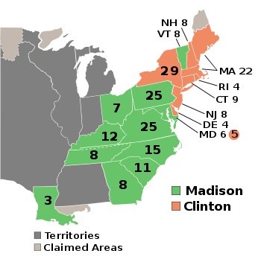
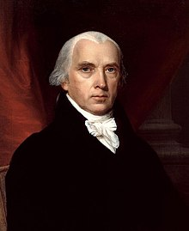
Madison Re-Elected

Slide 3
The War of 1812
By Comparison:
-Brits & Canadians capture American forts;
-Brits & Canadians take control of the Great Lakes
-Brits & Canadians take control of land held by Natives
-US pushed back again in 1813
USA still a young nation
Ill-trained and ill-disciplined military
Old leadership
Looking to Canada
British presence—and weakest—in Canada
Squash British presence / Native ties
More land
Ill-fated in 1812
Three-prong invasion pushed back as we crossed the border
US Looks to use of its Navy
-Performs better than its army
-Better craft, gunners, crews than British
-Goal is to gain control of Great Lakes
-Capture British fleet—boosts morale
-Other Redcoats forced to flee

Slide 4
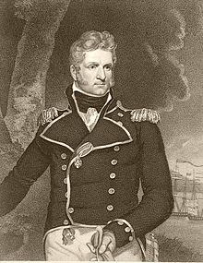
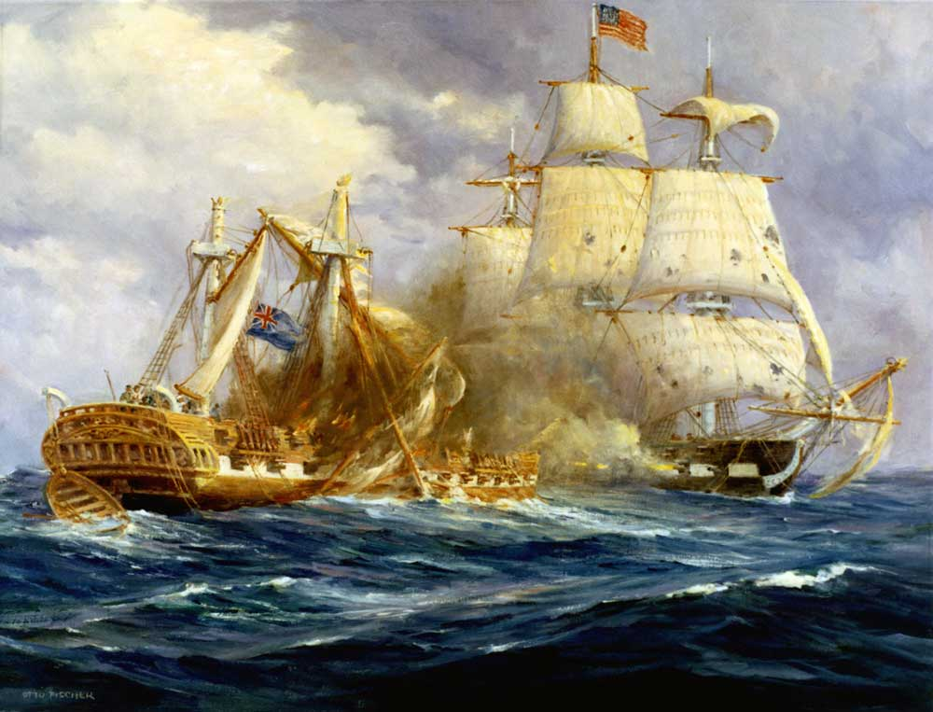
The War of 1812
US has some successes—
Defending its territory more than fanning out
More British pour in to the country
10,000 troops!
British aim for New York
US defeats British near Plattsburgh (naval battle)
Almost lose—Thomas Macdonough

Slide 5
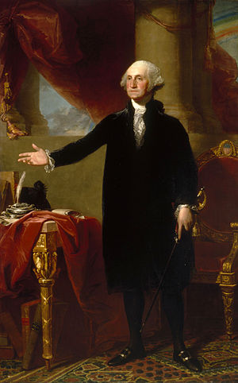
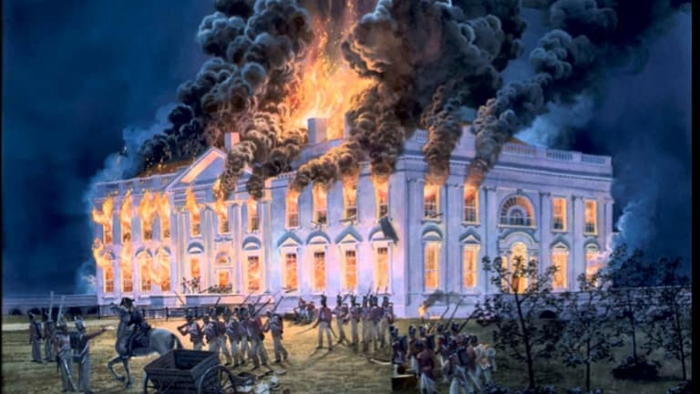
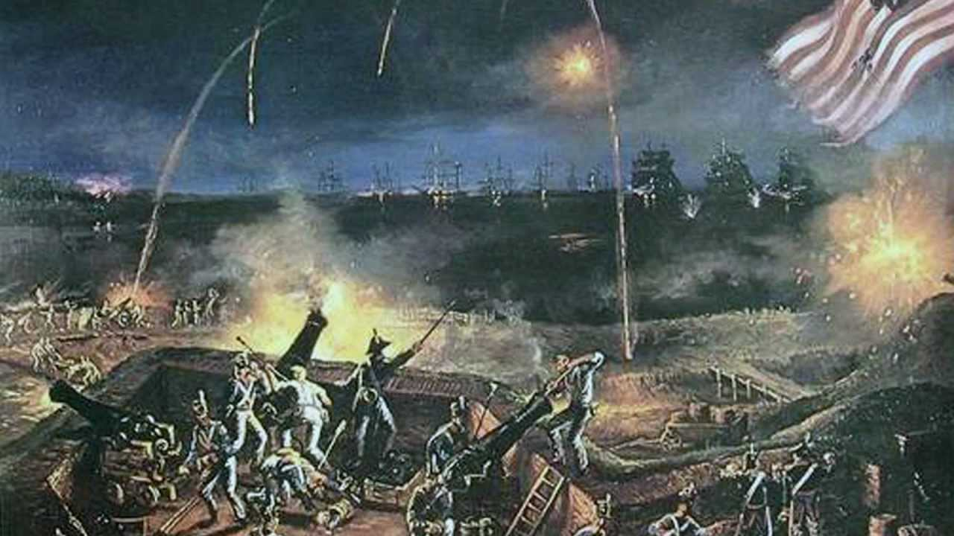
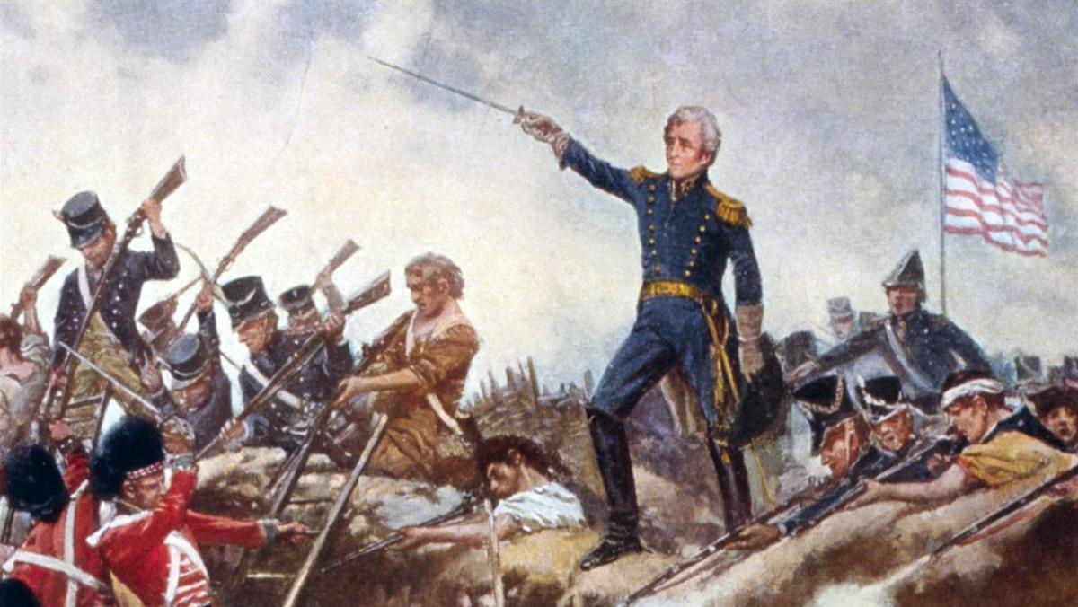
Washington, D.C. & New Orleans
British also come in through Chesapeake region, 1814
US militia men flee
Washington, D.C. burned
Capitol, White House
British also take fight to Baltimore / Ft. McHenry
Americans hold firm
Francis Scott Key
British aim at New Orleans
Andrew Jackson
Sailors, pirates, French, militia, free blacks
British outnumber Americans; lose
2,000 casualties within a half-hour
Surge in American pride; Nationalism
----
War had ended by treaty two weeks prior
-----
Britain will respond by blockading American coasts—no $

Slide 6
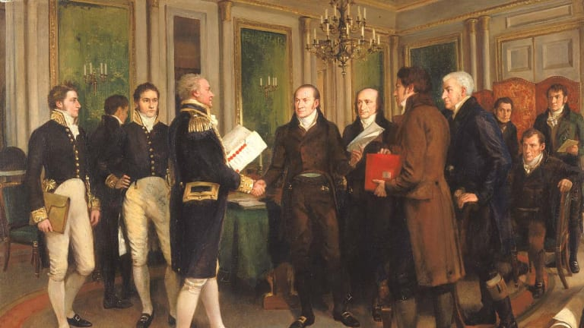
Treaty of Ghent, 1814
Rejected by Americans
British demands
Neutralized Indian Buffer state
Control of Great Lakes
Parts of Maine
England still dealing with aftermath of Napoleon / France
Treaty signed declaring an armistice—
Agree to stop fighting; no real winner or loser in War of 1812 *(a ‘forgotten’ war)*
“Not one inch of territory ceded or lost!”

Slide 7
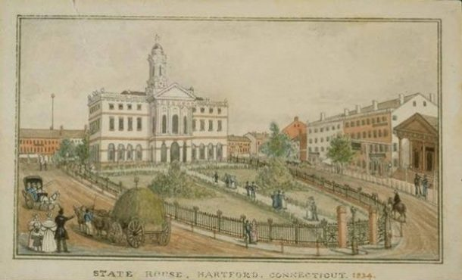
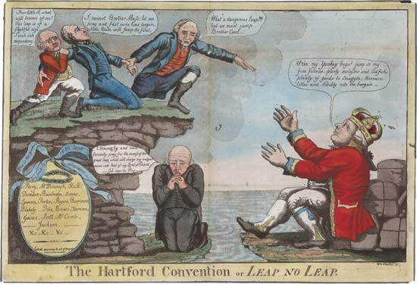
The Hartford Convention
Meeting of New England states--1814
Opposed to the war
Proper during war (illegal trade)
Some states call for secession
Meeting of twenty six individuals to redress grievances
Final list of demands
Financial assistance to compensate for lost trade
Proposed amendment requiring 2/3 vote in Congress before enacting embargos, admitting new states, or declaring war
Abolishment of the 3/5 Compromise
Limit presidents to one term
No two successive presidents can serve from the same state (ie, Virginia)
Most of these demands stem from a “North vs. South” mentality—don’t want to lose their spot at the top!
Problem: Demands come as news of Jackson’s victory spreads. Federalists seen as “unpatriotic” and the party essentially dies

Slide 8
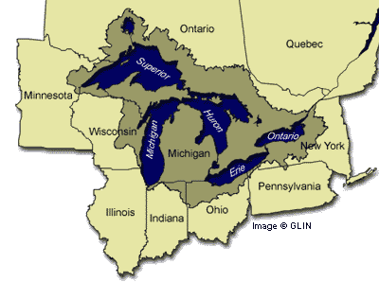
Significance of the War of 1812
The Bank will be revived
Washington will be rebuilt
The Military will grow
Technically a draw, but US doesn’t lose to Britain. Again!
US more respected abroad
Surge of nationalism
Still see sectionalism in USA
North vs. South / Industry vs. Agrarian
Death of the Federalist party
Rise of military heroes
Andrew Jackson; William Henry Harrison
Further displacement of Natives
Industry grows—more self-reliant!
Rush-Bagot, 1817

Slide 9
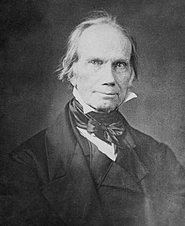
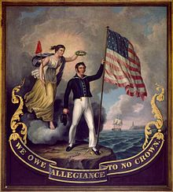
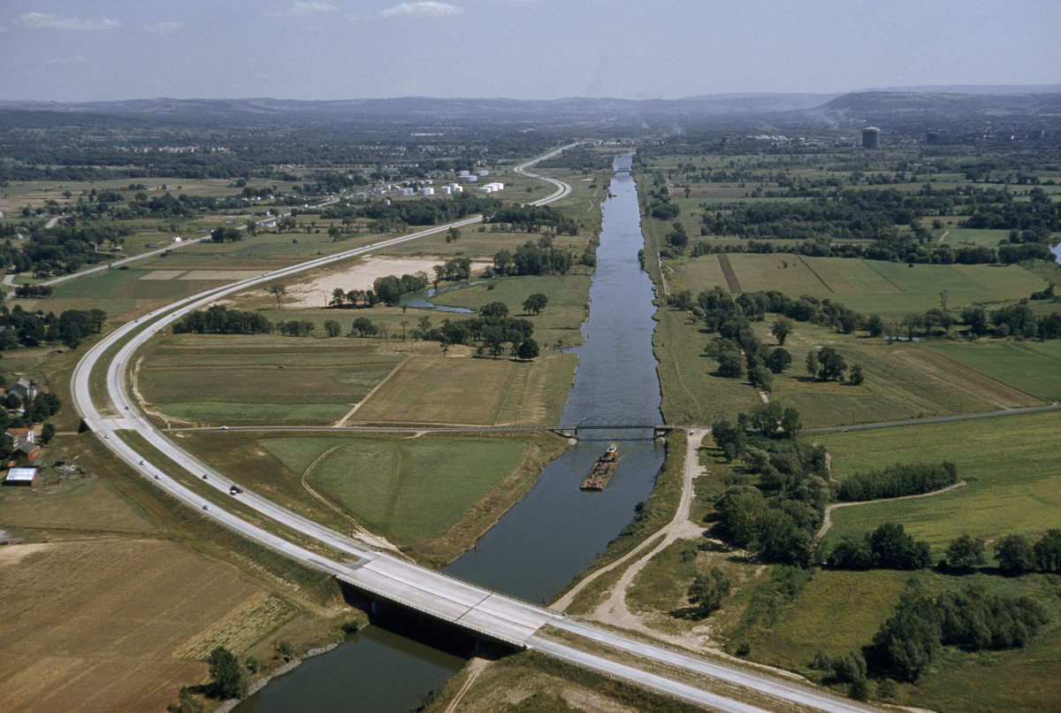
The American System
England can’t win on the battlefield—look to strangle US economy
Undercut US industry
Congress responds—Tariff of 1816
20%-25% of imports’ value
Not enough, but it’s a start
Henry Clay’s American System, 1824
Strong banking system—credit
Strong tariffs—grow manufacturing
Network of roads and canals (Ohio)—transport
Congress votes to pass 1.5 million dollars to the states to fund the transportation projects—Madison vetoes it as unconstitutional
States left to their own devices
Erie Canal, comp. 1825

Slide 10
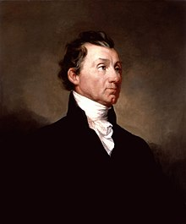
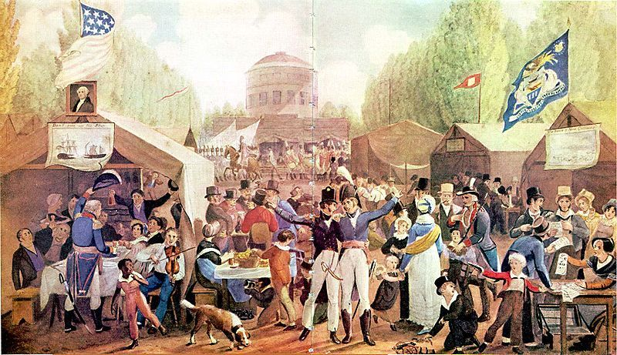
The Era of Good Feelings
James Monroe (R) elected in 1816
Bridged two generations
Founding Fathers
New age nationalists
“Meh” compared to previous presidents
BUT—he was keen as to what the people wanted
Good will tour
Military inspections
Meet the people—embraced
Despite the “good” – sectionalism, disputed territories, tariffs, etc.

Slide 11
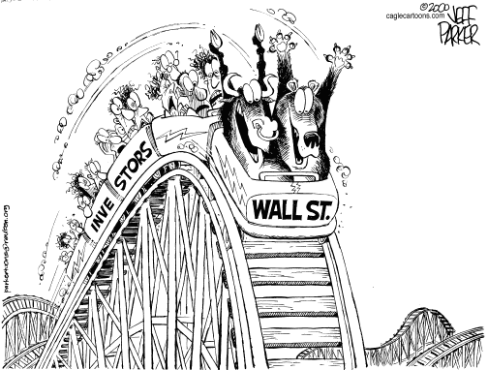
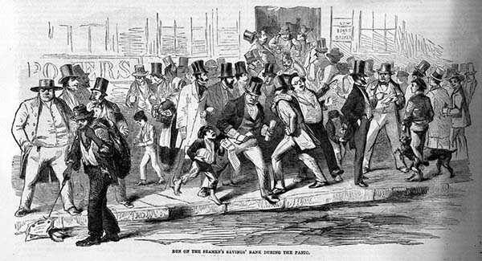
Panic of 1819
Bull and Bear Market; Economic Roller Coaster
1819—marked by economic trouble
Deflation, depression, bankrupt, bank failures, unemployment, soup kitchens, etc.
Cause: overspeculation in frontier [state banks printed own money; loaned it out]
Ex: State Championship game; 4th down. 4th quarter. 5 seconds lef5. Three points down.
Do you kick the field goal or go for the win?
Effect:
Foreclosures on mortgages and farms
Distrust of government (banks)
Loss of the “good feeling”
Imprisonment; separation of families

Slide 12
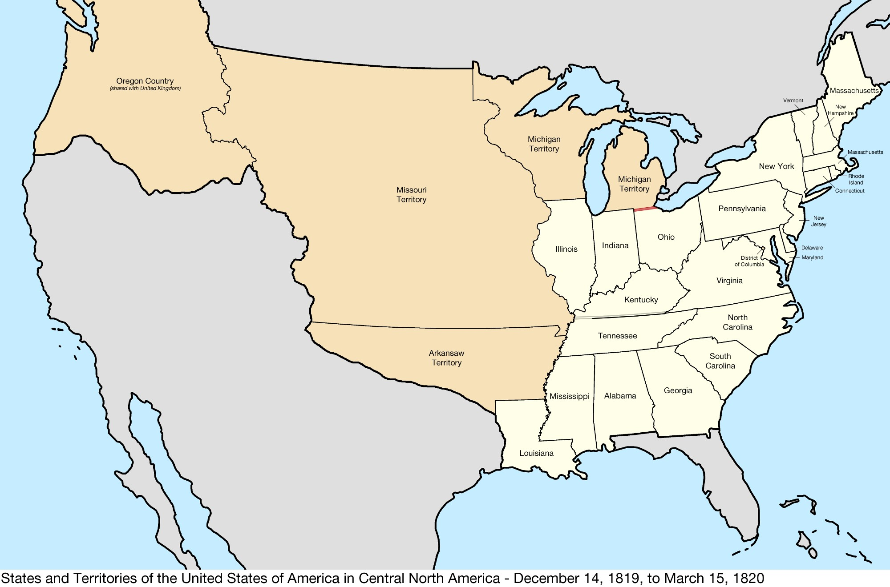
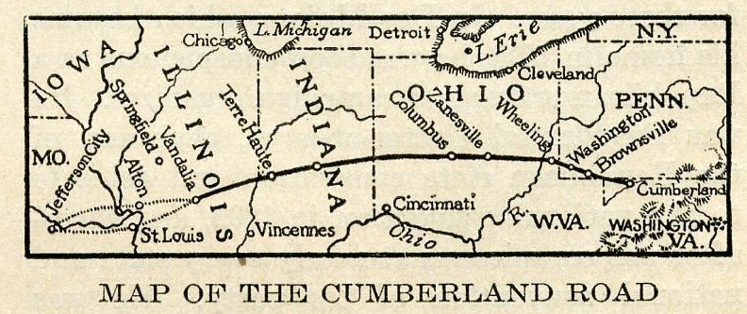
Moving West
Nine additional states added between 1791-1819
Admitted alternately - free / slave / free / slave
Why?
Continued movement
Search for fertile soil
Defeat of Natives opens more land
Highways and transportation routes
Settlers out west not politically important yet—not enough people
Still demand cheap land
Land Act of 1820 : $1.25 per acre (roughly $27)
Still demand cheat transportation routes
Still demand cheap money from banks

Slide 13
Slavery and Sectionalism
US continues to grow → Missouri has enough citizens to warrant statehood
Tallmadge Amendment: no more slaves brought in to Missouri; children born to slaves to be emancipated
Did not pass the Senate
Rise of sectionalism / rivalry between the North and the South
Importance of the Connecticut Plan
Concerns among Southerners—what is to come of future states—and older states?
Solution: Missouri Compromise (lasts 30+ years—kicking bucket down the road)
What you need to know: 36⁰30’

Slide 14
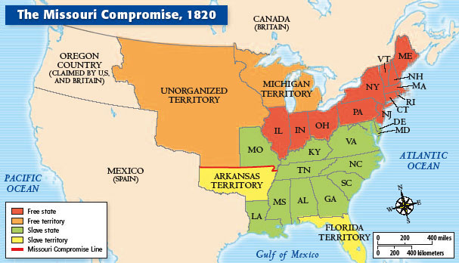
Missouri Compromise
Despite the sectionalism, the Panic of 1819, the Slavery Issue—Monroe was Re-elected in 1820.
The only president to be re-elected after being in office during a financial meltdown

Slide 15
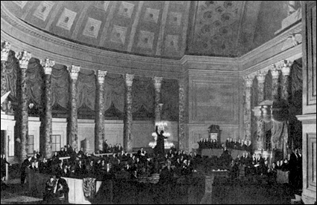
The Marshall Court
John Marshall-still Chief Justice (20+ years); Still Federalist
Long line of court rulings giving power to the federal government over states
McCulloch v. Maryland
Struck down Maryland’s attempt to dissolve and tax a branch of the Bank of the US
Cohens v. Virginia
Case involved people illegally selling lottery tickets—initial state court ruling upheld
HOWEVER—granted the SCOTUS the right to review all state supreme court rulings
Gibbons v. Ogden
Struck down NY and NJ attempts to grant a monopoly and use waterways as a means for interstate commerce
Interstate Commerce decisions were up to the federal government, not state governments

Slide 16
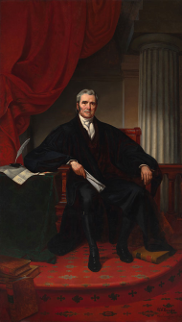
The Marshall Court
Fletcher v. Peck
Georgia’s legislature granted land to private speculators out of bribery
The next legislative session, the offer is rescinded
Marshall Court upheld the original sale as a contract
Property rights and federal government’s role
Dartmouth College v. Woodward
Dartmouth College granted character by King George III in 1769
New Hampshire legislature tried to change it—challenged
Court ruled that the charter must stand—it’s a contract

Slide 17
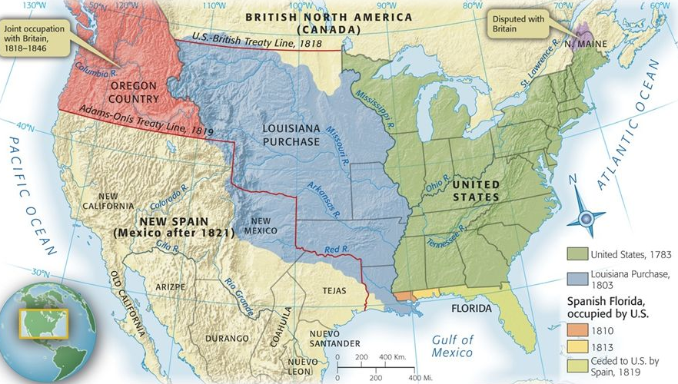
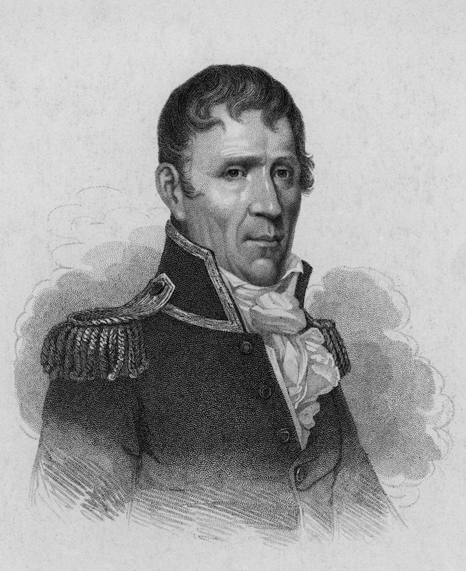
Oregon and Florida
James Monroe and John Q. Adams
Anglo-American Convention
Americans share Newfoundland fisheries with Canada
Ten-year joint occupation of Oregon
US picks up Florida in 1819
Spain dealing with its own revolutions, has to move troops
Andrew Jackson moves in to deal with “hostile” Indians and slaves
Goes further than allowed by Federal government
Adams-Onis Treaty—Span cedes Florida, parts of Oregon
US abandons claims to Texas

Slide 18
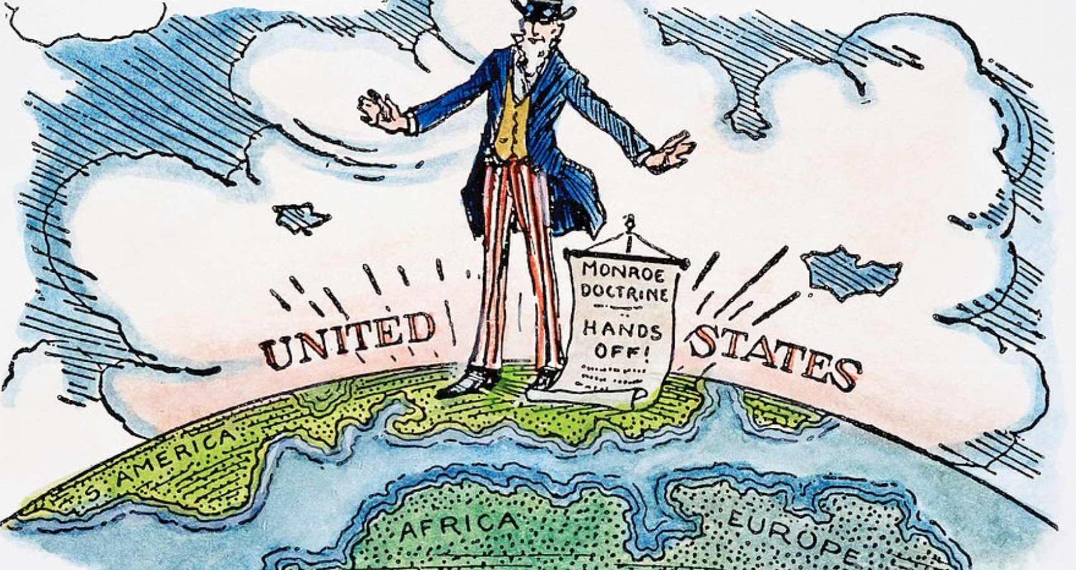
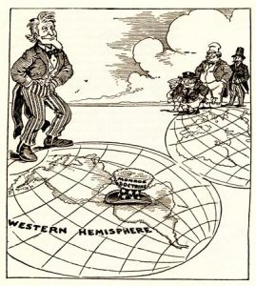
The Monroe Doctrine
Fear of outside interference in the American hemisphere by outsiders
Russia, Europeans
December 2, 1823
Non-colonization: America is closed to colonization
Nonintervention: Europe, stay out of the western hemisphere
“Self-defense” doctrine
Not about protecting other countries in the Americas
About protecting us—still young and weak!
“Insulating” the US
Infuriated European leaders—but their hands were tied

Slide 19
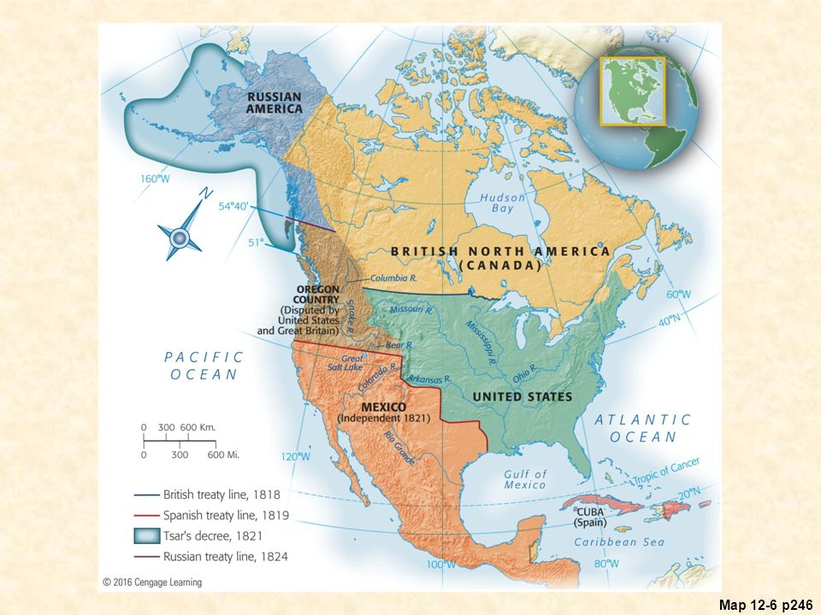

Slide 20
